Slide 1
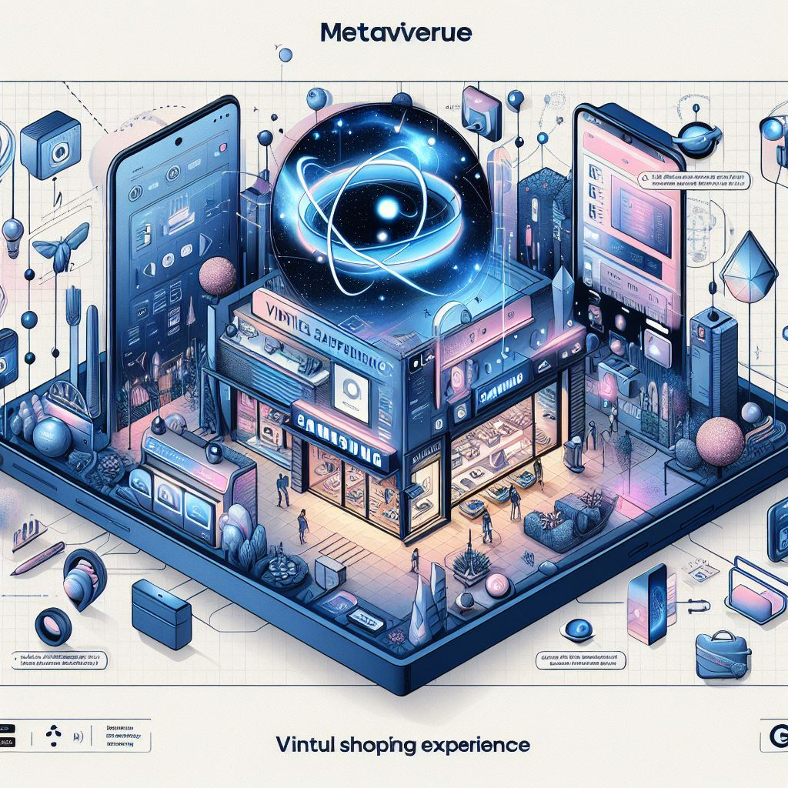
Transforming Retail with Extended Reality
SAMSUNG META STORE
TEAM PHOENIX
Shival Gupta
George Mathew Paul
Sivaraghavi U. R.
Trisha Bhavini

Slide 2
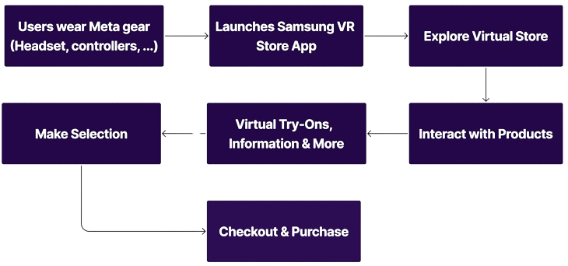
Concept Diagram

Slide 3
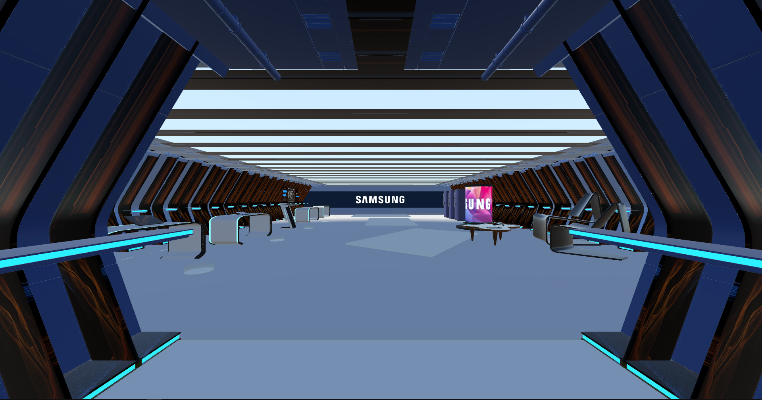
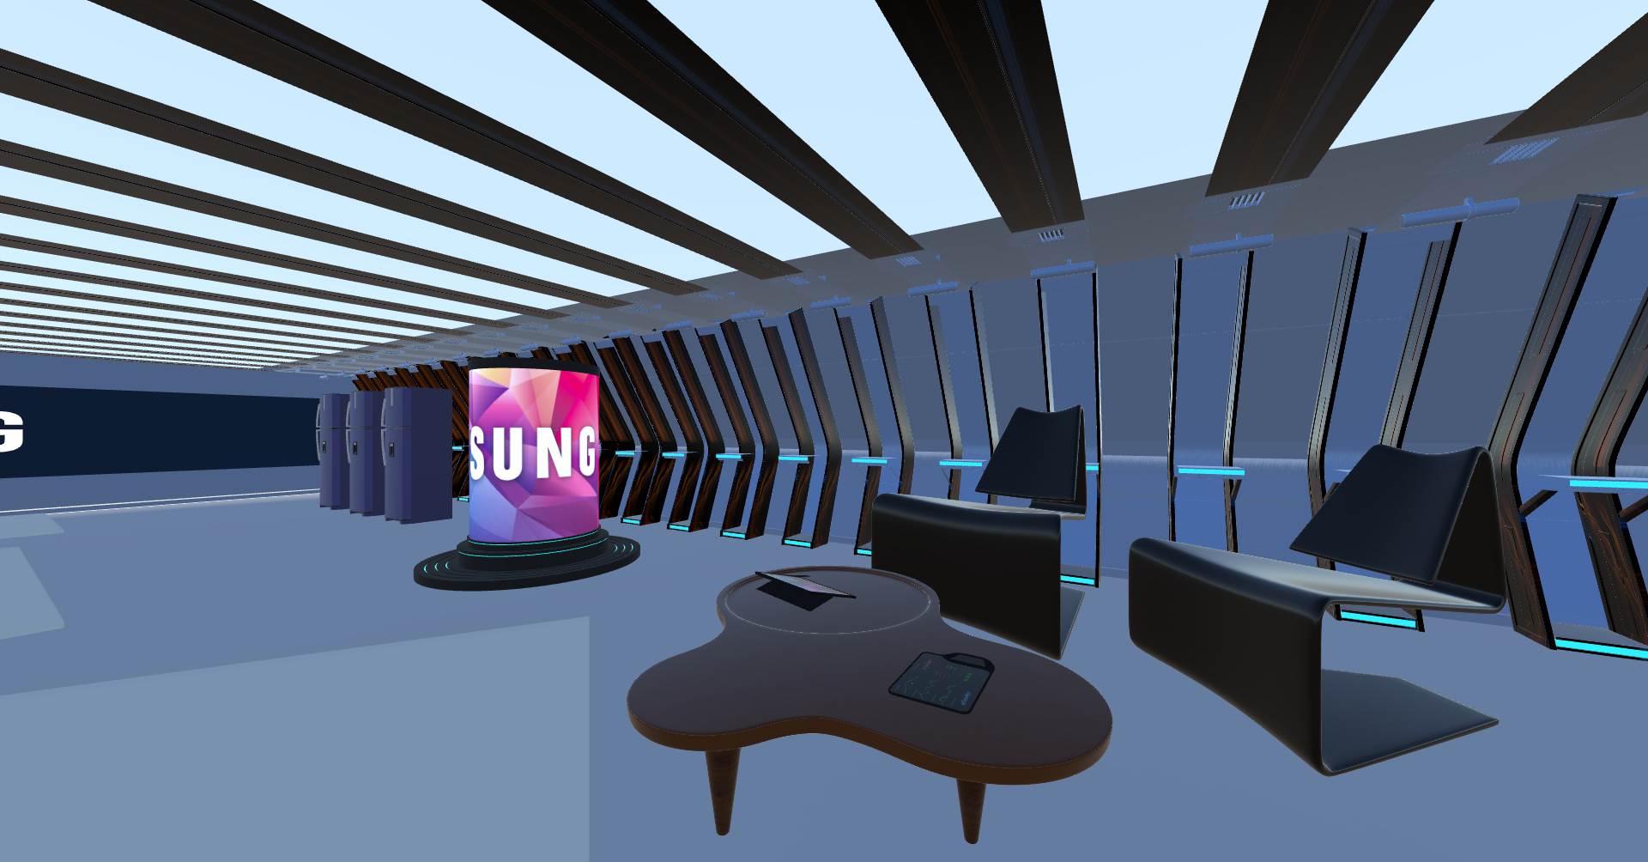
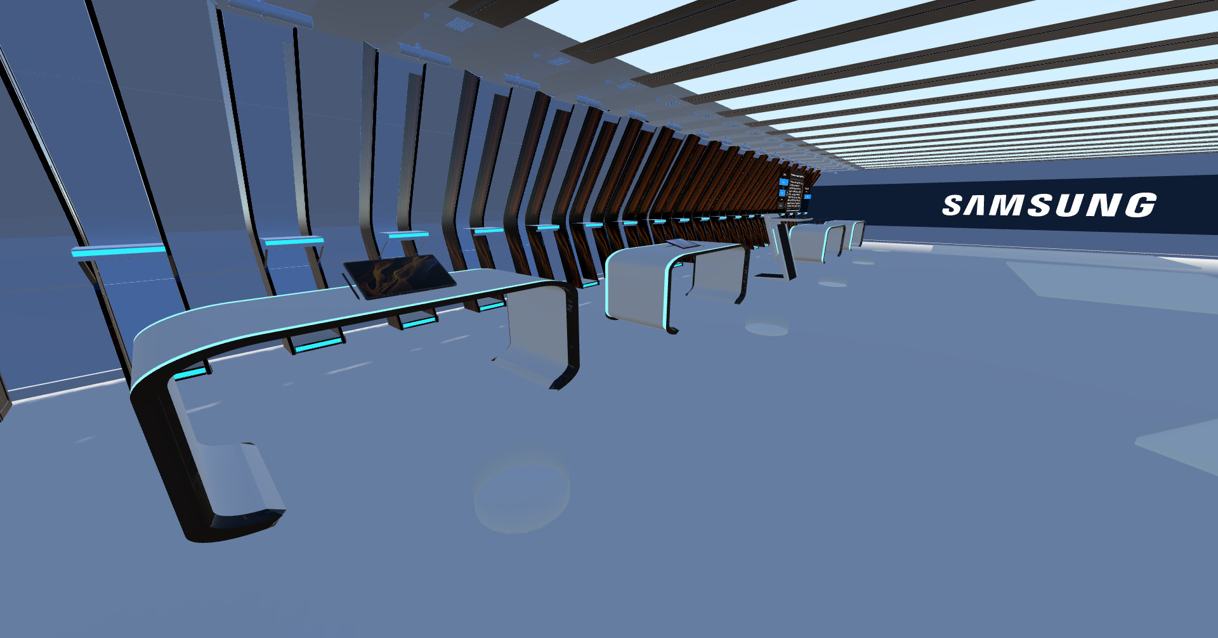
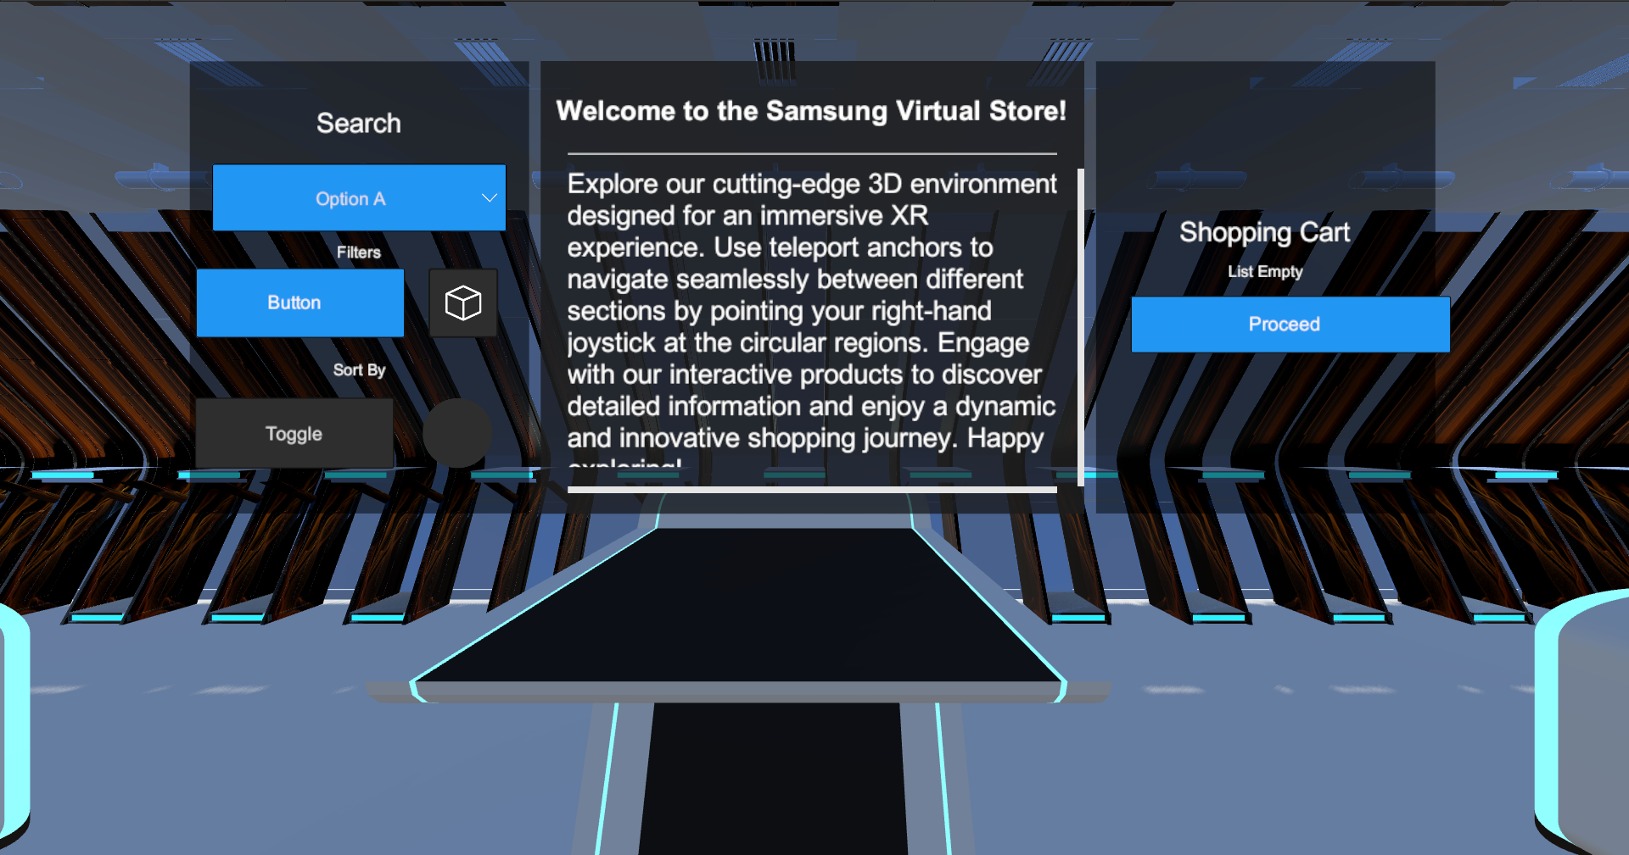
Virtual Samsung Store Preview

Slide 4
Tech Stacks
Unity 2022.3
Blender 4.1
OpenXR 1.10.0
XR Interaction Toolkit 2.5.4
Supported Devices
Valve Index Controller Profile HP Reverb G2 Controller Profile
HTC Vive Controller Profile
Microsoft Motion Controller Profile
Microsoft Hand Interaction Profile
Hand Interaction Profile
Meta Quest Touch Pro Controller Profile
Oculus Touch Controller Profile

Slide 5
Features Implemented
Future Scope of Work
Immersive 3D Virtual Store: Experience a fully-rendered 3D environment designed for XR.
Effortless Navigation: Use teleport anchors to quickly move between locations by pointing the right-hand joystick at circular regions.
Interactive Products: Access detailed product information through interactive selections.
Virtual Try-On: Experience wearing Samsung devices like smartwatches and using phones or tablets. This feature provides a realistic preview of how products look and feel.
Search Feature: Filter Samsung devices by criteria such as budget, storage, and Galaxy series to find the perfect product.
Add to Cart & Purchase: Easily add items to your cart and complete purchases with a smooth, secure transaction process directly from the app.

